Slide 1

How to build a pipeline.
Rendering

Slide 2
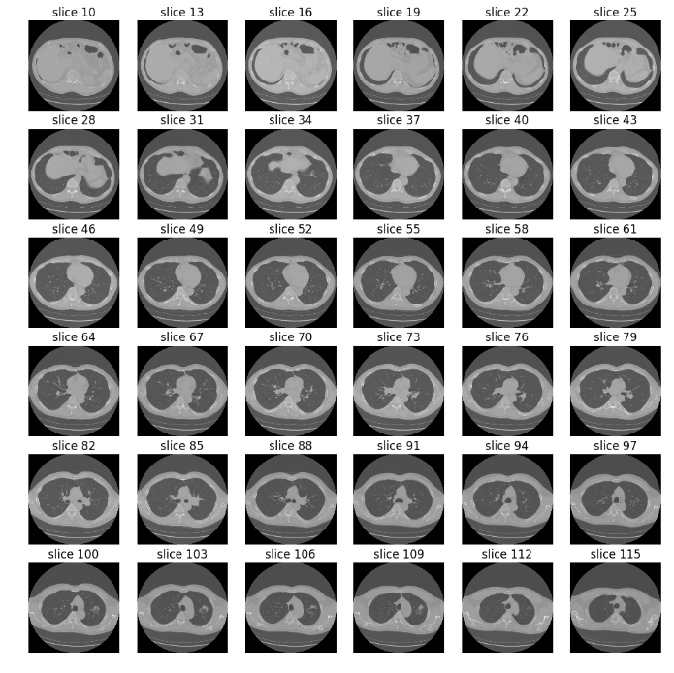
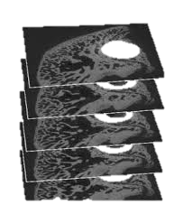
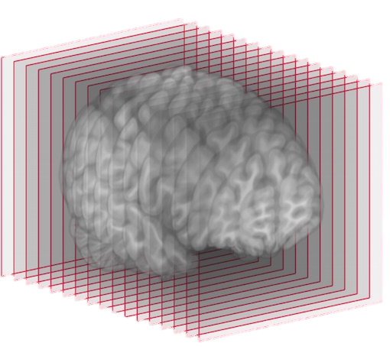
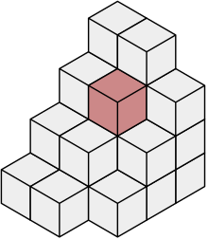
Volume Rendering
Scanner acquires 2D slices, with spatial information. Slices of constant distance and orientation are stacked to form our volume of interest. 3D pixels are referred to as “Voxels”.
Overall goal is to produce accurate, high quality, images of any cross-section from the volume.

Slide 3
1. Understanding the requirements
Fast efficient rendering of CT (Computed Tomography), MR(I) (Magnetic Resonance Imaging) datasets.
Support multiple volume rendering techniques. Windowing, MPR, CPR…,MIP, MinIP, AvIP…Colour mapping.
Diagnostic quality (Interpolation, Isometric Projection)

Slide 4
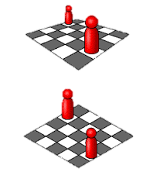
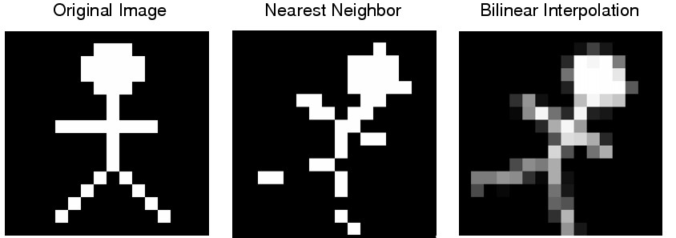
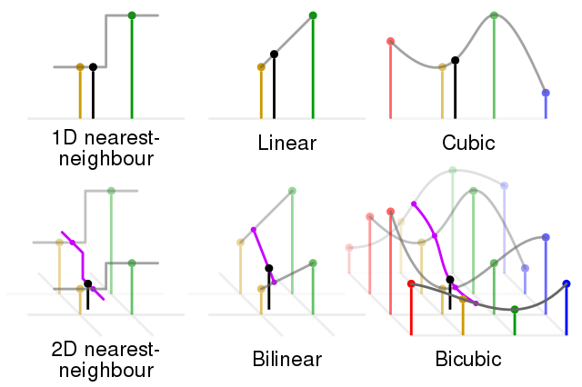
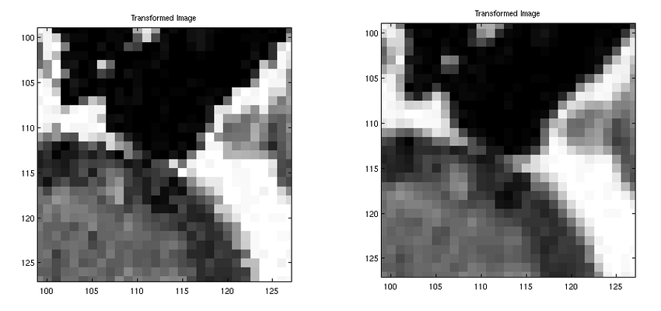
1. Understanding the requirements
Diagnosic quality.
Isometric Projection(3D):
Preservation of distances is crucial.
No warping of 3D space.
Measurements in real world. (Scaled)
Interpolation
Reduce aliasing effects.
Produce smooth images, form any orientation.
Perspective projection
Isometric projection

Slide 5
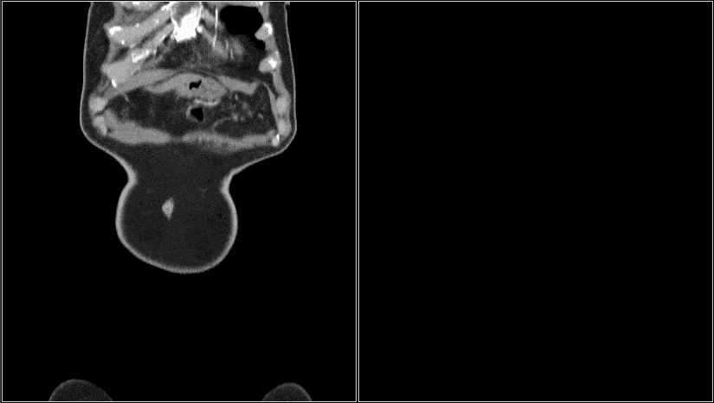
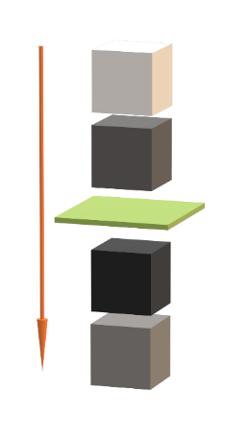
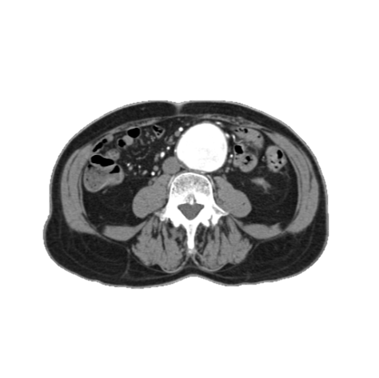


1. Understanding the requirements
Average Intensity Projection (AvIP)
Tracing the ray through the pixel of interest, of n mm depth, take the average attenuation.
Pixel
Ray
1mm AvIP
10mm AvIP
100
$$\frac{1}{n}\sum_{i=1}^{n}{a_{i}}=\frac{1}{n}\left(a_{1}+a_{2}+…+a_{n}\right)$$
300
Pixel
Window
$$\frac{100+300+400+200}{4}=250$$
400
200
10mm

Slide 6
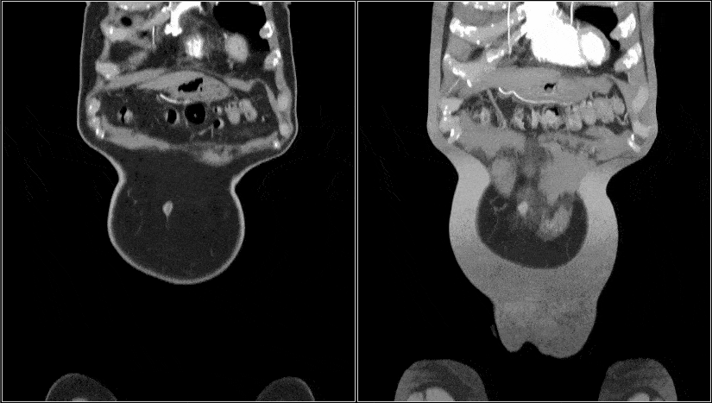


1. Understanding the requirements
Maximum Intensity Projection (MIP)
Tracing the ray through the pixel of interest, of n mm depth, take the largest attenuation.
Pixel
Ray
1mm MIP
10mm MIP
100
$$\max\left\{a_{1},…,a_{k}\right\}$$
300
Pixel
Window
$$max⁡(100, 300, 400,200)=400$$
400
200
10mm

Slide 7
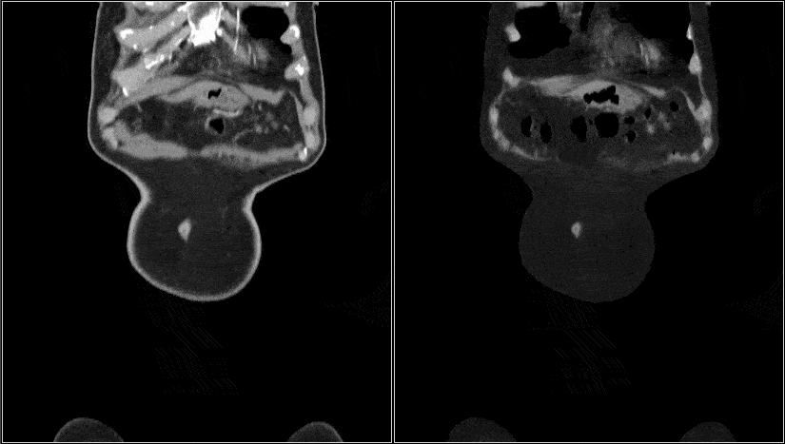


1. Understanding the requirements
Minimum Intensity Projection (MinIP)
Tracing the ray through the pixel of interest, of n mm depth, take the lowest attenuation.
Pixel
Ray
1mm MIP
10mm MIP
100
$$\min\left\{a_{1},…,a_{k}\right\}$$
300
Pixel
Window
$$min⁡(100, 300, 400,200)=100$$
400
200
10mm

Slide 8
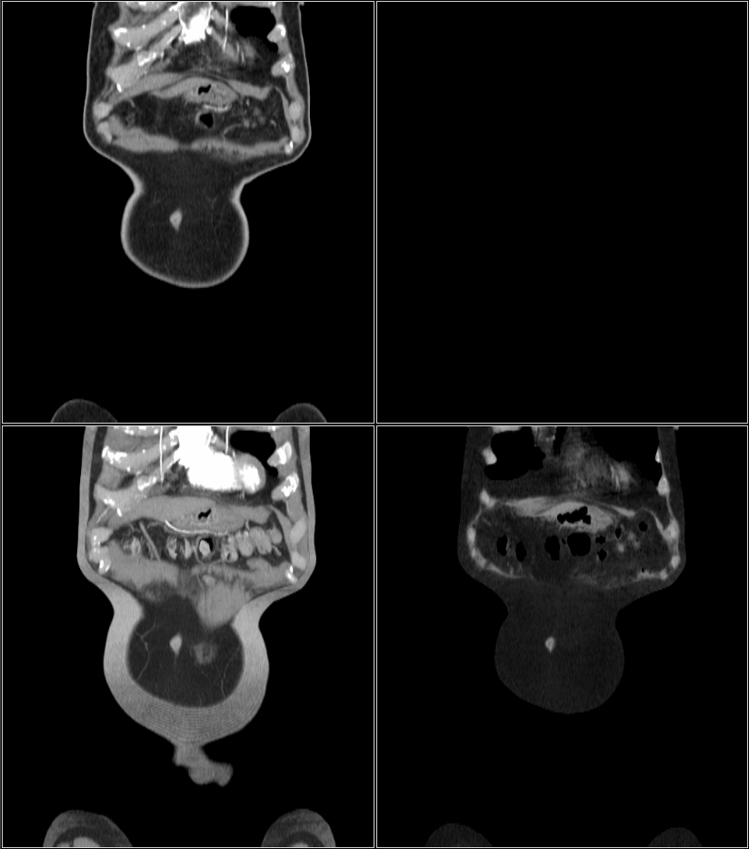
1. Understanding the requirements
Side by Side Comparison
1mm
10mm AvIP
AvIP – Isodense structures are better represented. (Internal structures of a solid organs, Walls of hollow structures)
MIP – Hyperdense structures are better represented. (Vessels with contrast, dense bone)
MinIP – Hypodense structures are better represented. (Airways, Sinuses, Fat, Water)
10mm MIP
10mm MinIP
Notes:
Hyperdense (more dense)
Hypodense (less dense)
Isodense (the same density)
AvIP - Blood vessels, Intestine.
MIP – Vessels with high contrast, Dense bone.
MinIP – Airways, Sinuses, Fat, Water.

Slide 9
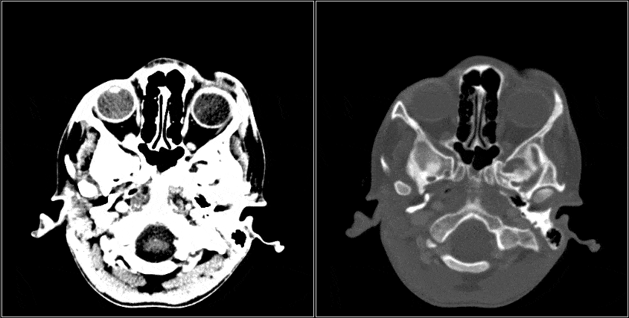
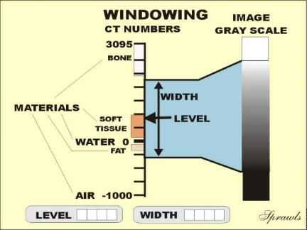
1. Understanding the requirements
Windowing / Window Level
Windowing (also known as grey-level mapping, contrast stretching, histogram modification or contrast enhancement) is the process in which the greyscale components are transformed; doing this will change the representation to highlight particular structures.
Also, this allows us to convert our data our final colourspace.
W:80 L:40 (Brain)
W:1800 L:400 (Bone)
Colour space
Notes:
Window width
The window width (WW) as the name suggests is the measure of the range of CT numbers that an image contains.
A wider window width (2000 HU), therefore, will display a wider range of CT numbers. Consequently, the transition of dark to light structures will occur over a larger transition area to that of a narrow window width (<1000 HU).
Accordingly, it is important to note, that a significantly wide window displaying all the CT numbers will result in different attenuations between soft tissues to become obscured ¹.
Wide window
Defined as 400-2000 HU best used in areas of acute differing attenuation values, a good example is lungs or cortical tissue, where air and vessels will sit side by side.
Narrow window
Defined as 50-350 HU are excellent when examining areas of similar attenuation, for example, soft tissue.
Window level/centre
The window level (WL), often also referred to as window centre, is the midpoint of the range of the CT numbers displayed.
When the window level is decreased the CT image will be brighter and vice versa.

Slide 10
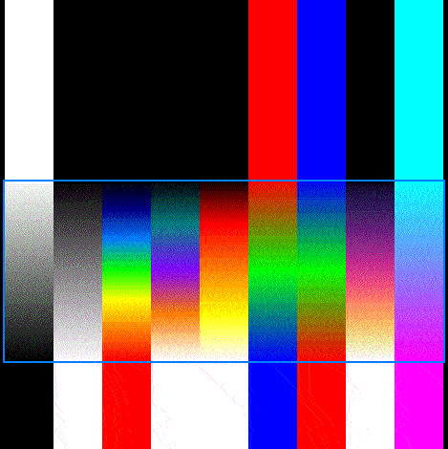
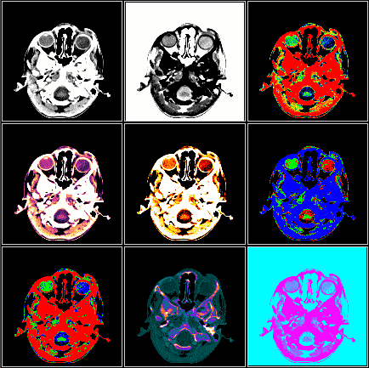
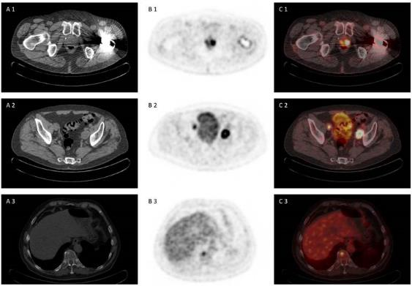
1. Understanding the requirements
Colour Mapping
Provides additional clarity for windows of interest in the data.
Additionally useful for PET/CT fusion, generating heat maps.
Colour Space
[0.0-1.0]

Slide 11
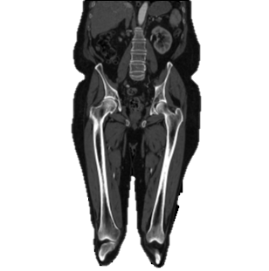
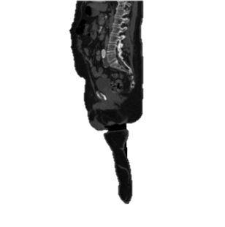
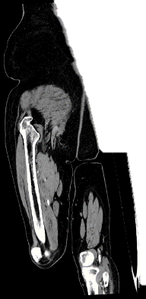
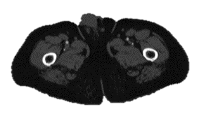
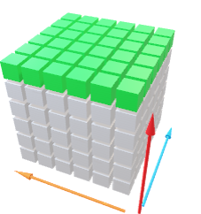
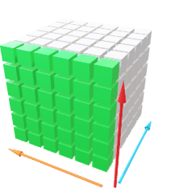
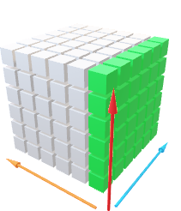
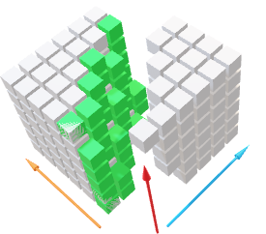
1. Understanding the requirements
Multiplanar Reconstruction (MPR)
Multiplanar reformation (MPR) is the process of projecting a cross-section of a volume onto a flat plane or slab to produce images that are no longer aligned to the acquisition plane.
Coronal
Axial
Sagittal
Oblique
Notes:
Data must be aligned.

Slide 12
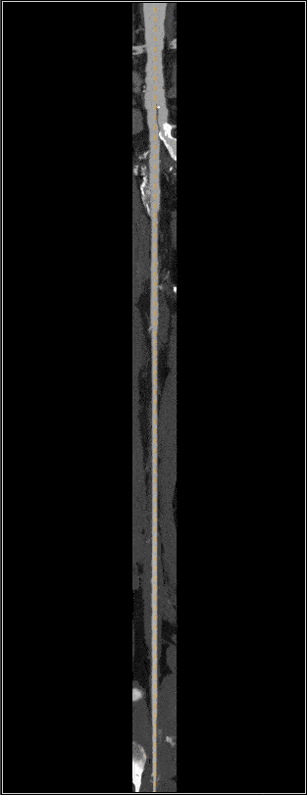
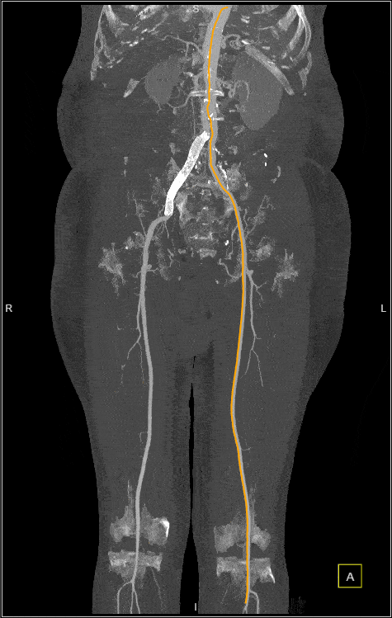
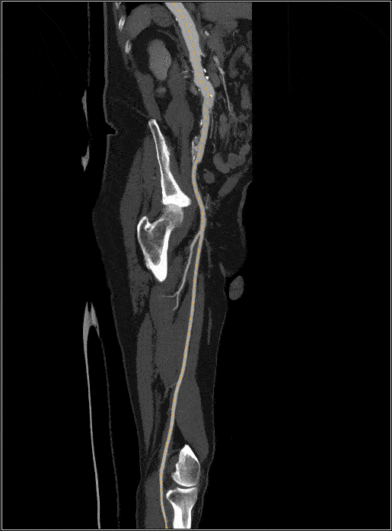
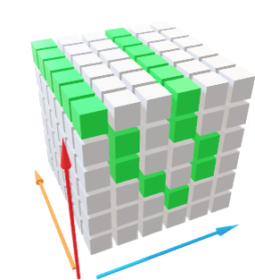
1. Understanding the requirements
Curved planar Reconstruction (CPR)
Curved planar reformation is a type of MPR accomplished by aligning the long axis of the imaging plane with a specific curved structure, such as a blood vessel, rather than with an arbitrary
imaging plane.
Straightened
CPR
Infinite MIP (Bone Removed)
Stretched CPR
Hyper Plane
Notes:
Data must be aligned.

Slide 13
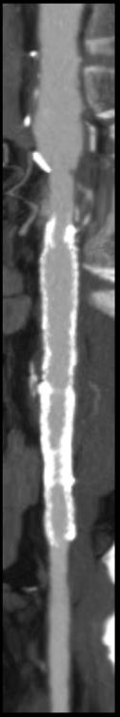
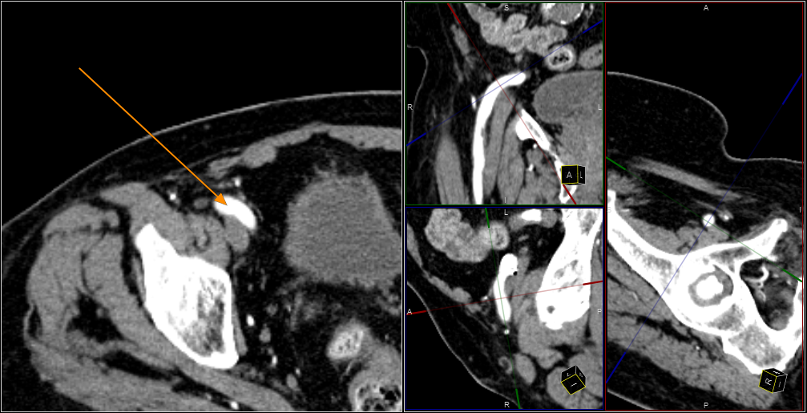
1. Understanding the requirements
Advantages of MPR Reconstruction
It enhances viewing of pathology.
It equips radiologists to deal with the large data sets that are available with the new multi-detector CT scanners and to more easily compare current and previous exams.
It improves service to referring physicians, since selected 3-D images can be attached to the radiology report. These images illustrate the diagnosis and may even be shown to patients while discussing the condition and recommended treatment.
Original Slice
Oblique Planes

Slide 14
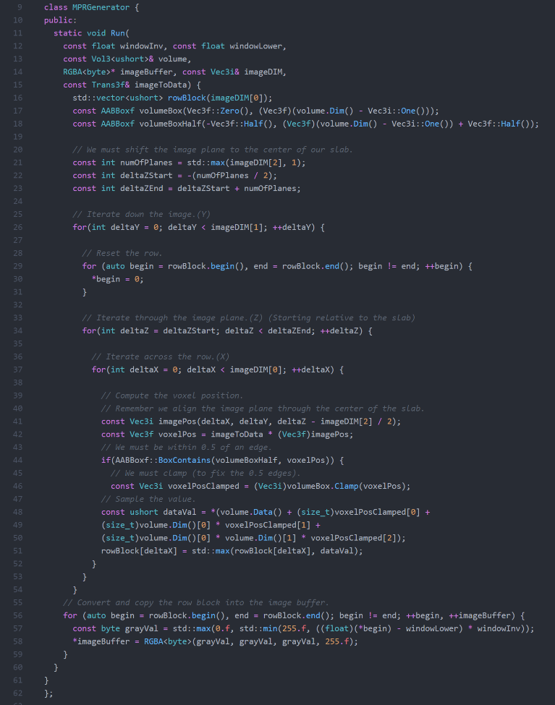
2. Prototype MPR
Notes:
CONS
Not reusable.
MIP only.
Prune to change. (After optimizations).
Frustrating between multiple developer all changing the same file.
Will become very large and obscure over time, as more features are added.
PROS
Simple, few lines of code (At the moment).

Slide 15
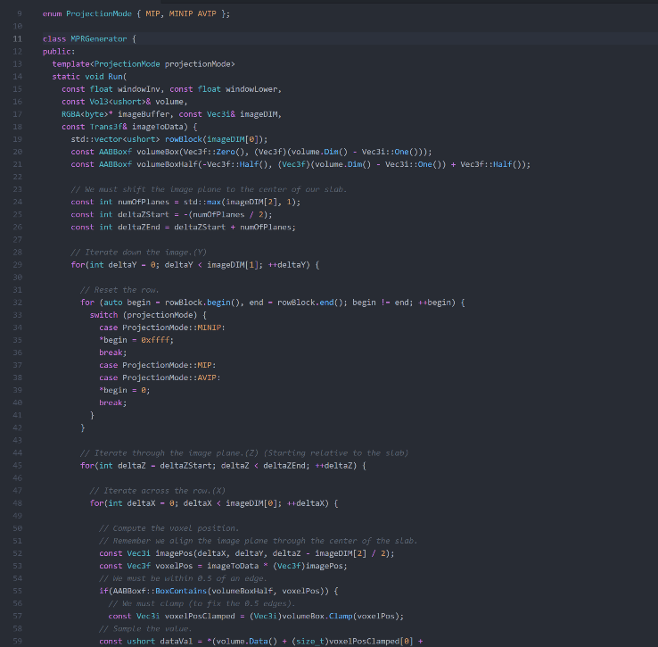
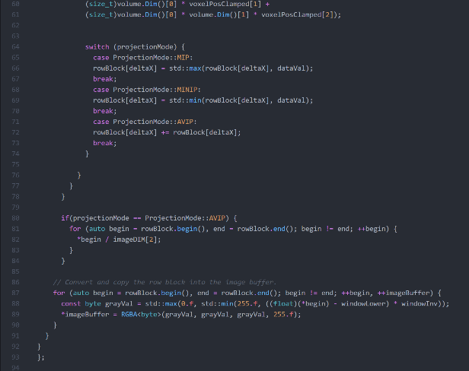
2. Prototype MPR (Template Constant)
Notes:
CONS
Still not reusable.
Prune to change. (After optimizations).
Frustrating between multiple developer all changing the same file.
Will become very large and obscure over time, as more features are added.
Double the lines of code.
PROS
No performance impact from adding the modes as compile time constant. Switches will be optimized away and multiple versions of the class will be created by the complier.

Slide 16
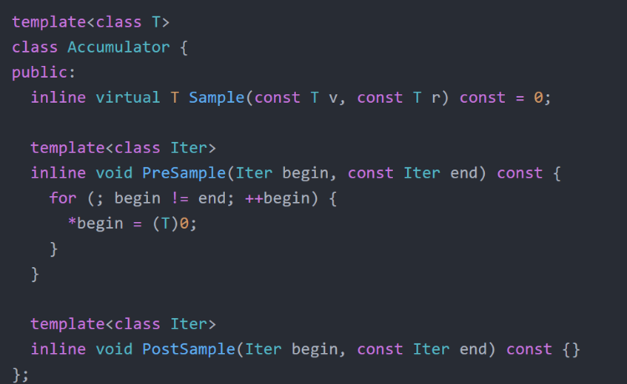
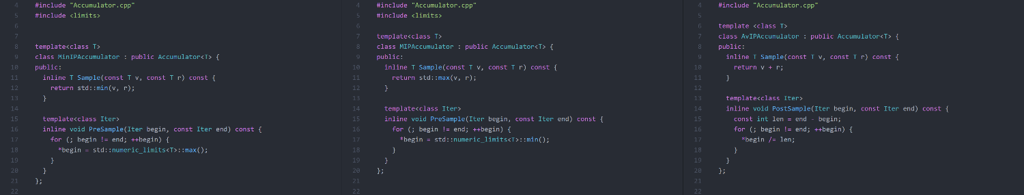
2. Prototype MPR (Polymorphic Templates)
Notes:
Polymorphism.
Polymorphism is the ability of an object to take on many forms.
PROS
Code is split up into small readable chunks.
Changes to the same files by multiple developers is less likely. And Implementations become stable and changed less frequently.
New Features can be slotted into the implementation, if the interface is designed well (generic / flexible enough)
CONS
More files for the compiler to aggregate. (Compiling gets slower) This can be helped by using precompiled headers.
Accumulator - One common interface, 3 implementations for MIP, MinIP, AvIP. More can be added.

Slide 17
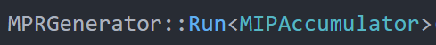
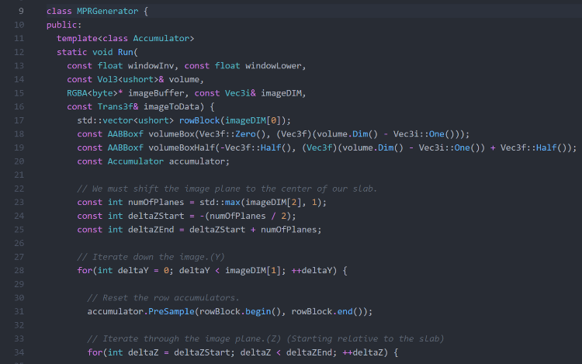
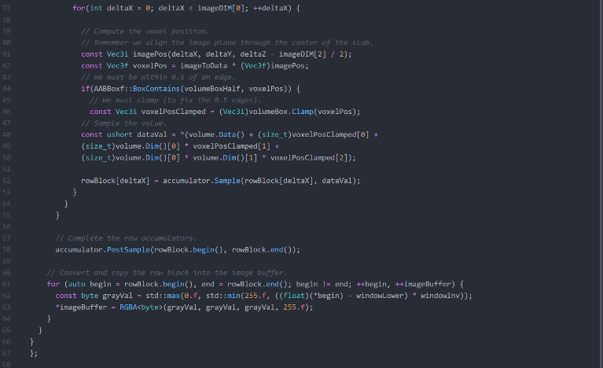
2. Prototype MPR (Polymorphic Templates)
Notes:
Compiler will create multiple versions of the class, one for each Accumulator used.

Slide 18
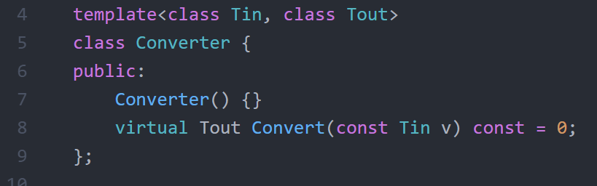
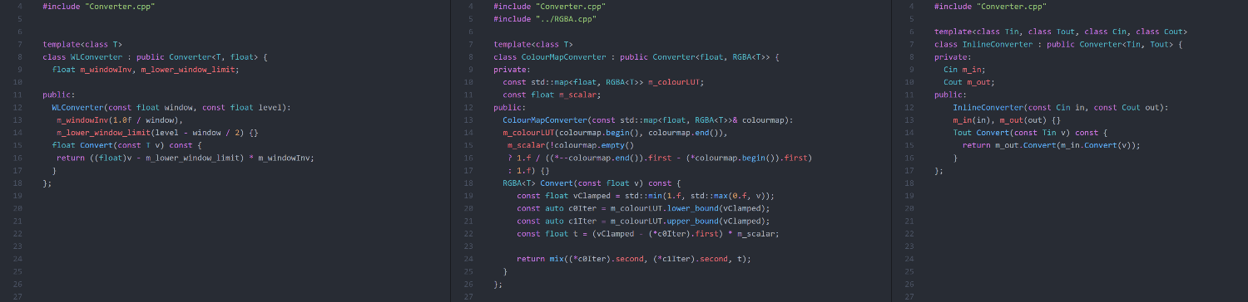
2. Prototype MPR (Polymorphic Templates)
Notes:
Converter - One common interface, 3 implementations for Colour mapping, Windowing, the third is used to chain Colour mapping and Windowing together so one converter is need for the MPR implementation.
More can be added such as thresholding and background removal.

Slide 19
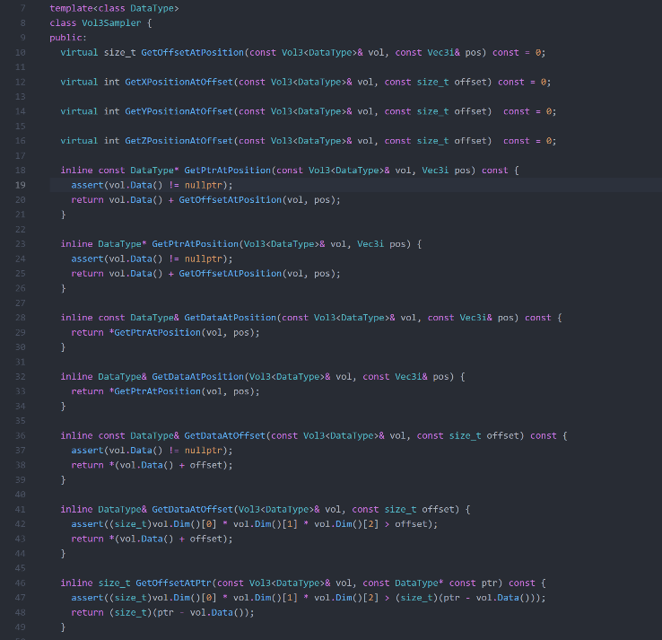
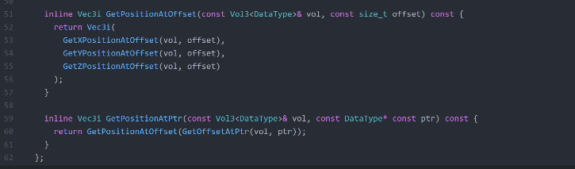
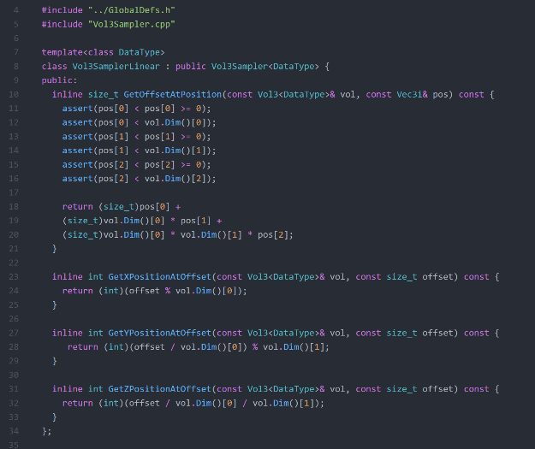
2. Prototype MPR (Polymorphic Templates)
Notes:
Sampler – One common interface allows use to define multiple memory layout techniques.
Such as linear volumes, block volumes.
Block volumes allow use to store the volume in memory with more spatial locality to maintain better L0 CPU cache locality, i.e 32x32x32 blocks of voxels.

Slide 20
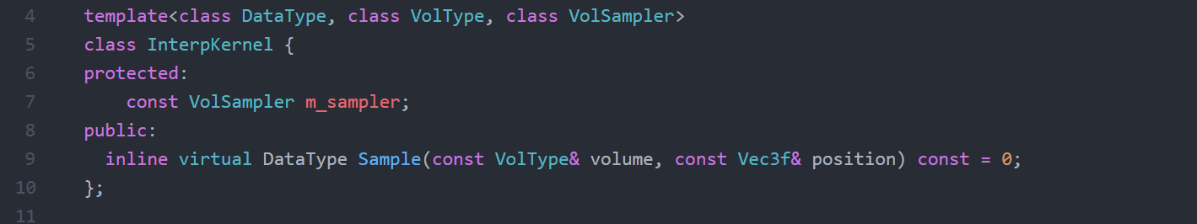
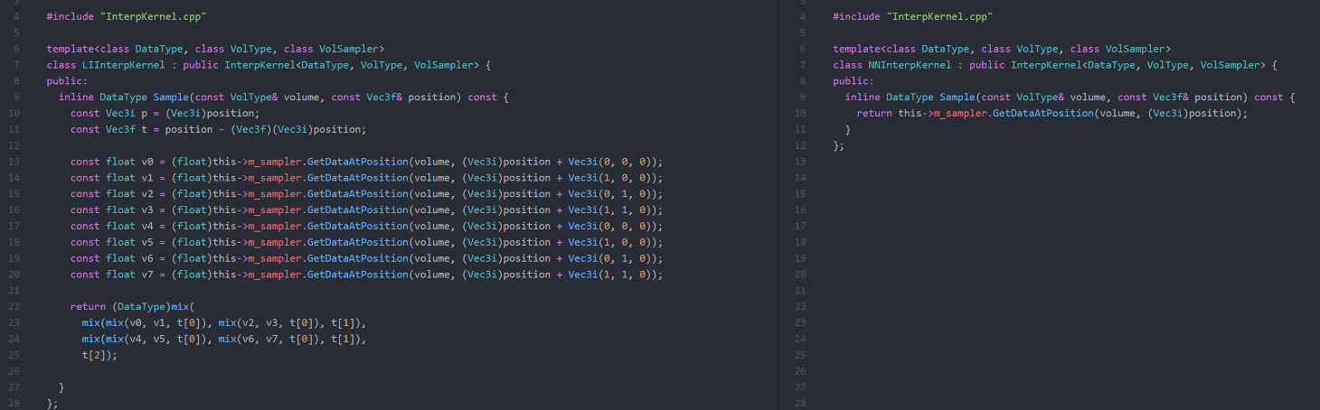
2. Prototype MPR (Polymorphic Templates)
Notes:
InterpKernel - Generalizing difference methods of interpolation.
Nearest neighbour / Linear neighbour, more can be added, and performance impacts can be better observed.

Slide 21
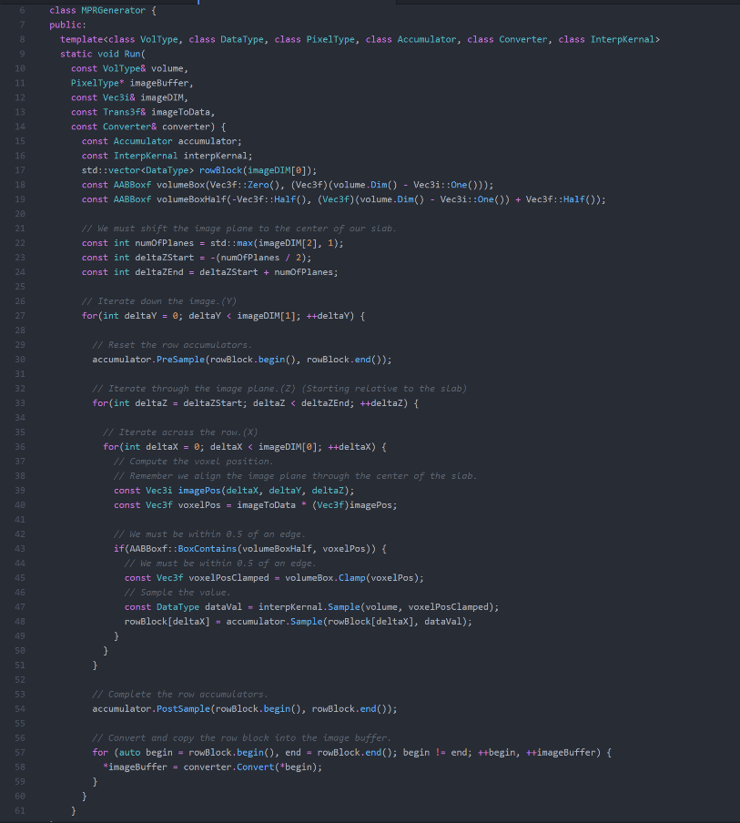
2. Prototype MPR (Polymorphic Templates)
Notes:
Final templatized version offers a lot of flexibility and generalization. We are back to 60 lines without loosing features!
This file will stabilize over time, and will unlikely be changed, due to the fact the accumulators, samplers, interpolators, and converters are all pulled out into
There separate components.

Slide 22
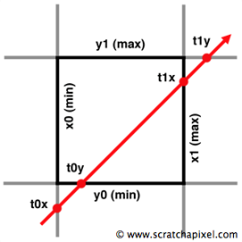



3. Generic Volume Renderer
Further reduce operations by removing certain checks per pixel.
Generalization to support multiple visualization techniques, such as CPR.
Notes:
Less operations per pixel, 512*512 image will produce 262’000 pixels.
Generalization, ongoing research is constantly creating new ways to visualize the data. So this should not require a rewrite down the line.
Ray-Box Intersection, with the volume and image plane.

Slide 23


3. Generic Volume Renderer
General Multithreading support.
Notes:
Generic Threading.

Slide 24


3. Generic Volume Renderer
Notes:
Utilized RowTransformer, ThreadedRendererThread functor design.

Slide 25
THANK YOU!
Questions?

